Slide 1
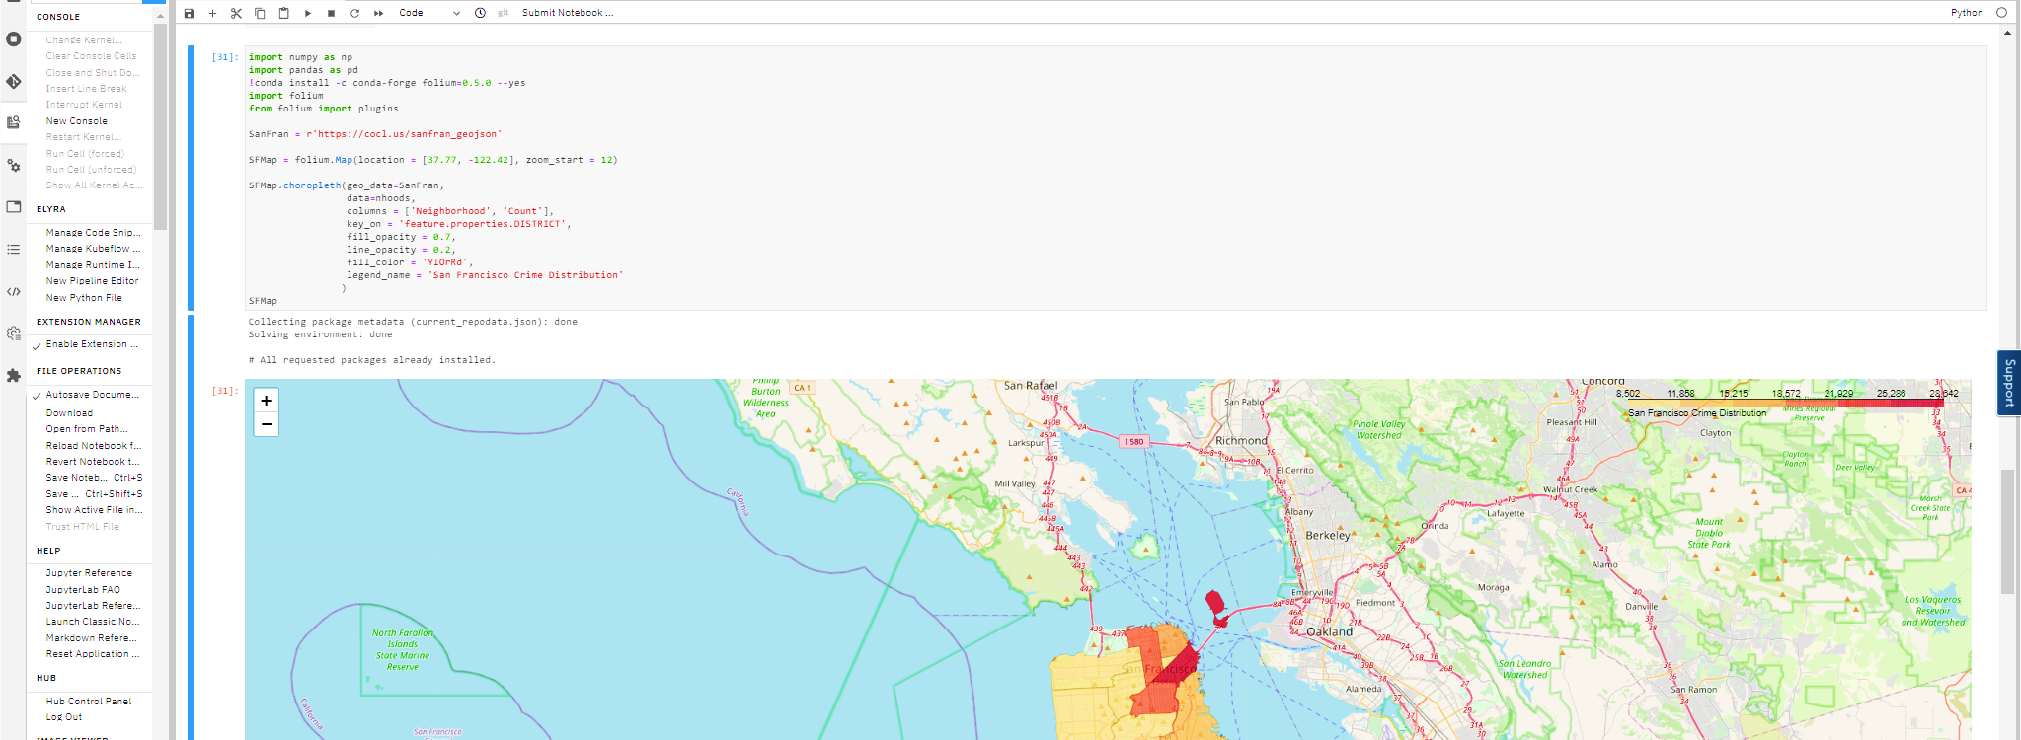


Applied Data Science Capstone Week 5 Project
Timothy Scott Marinaro

Slide 2
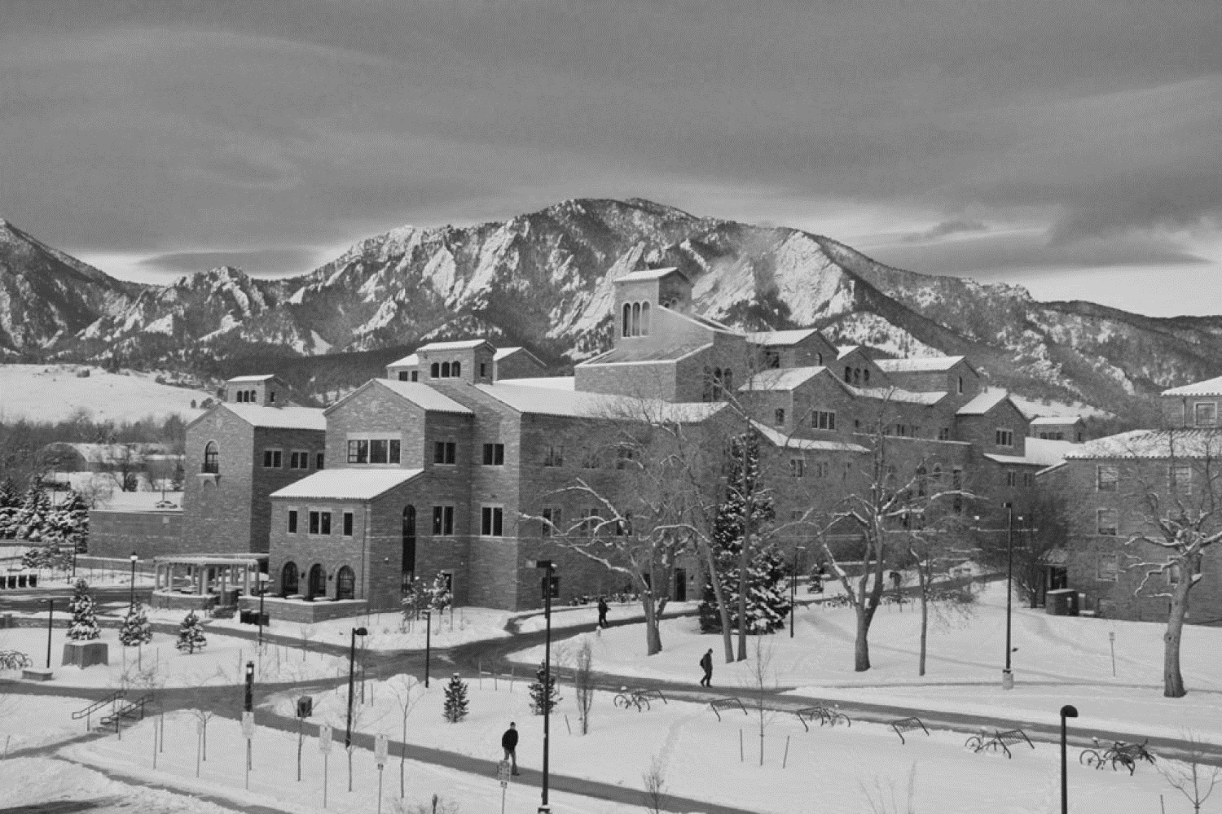
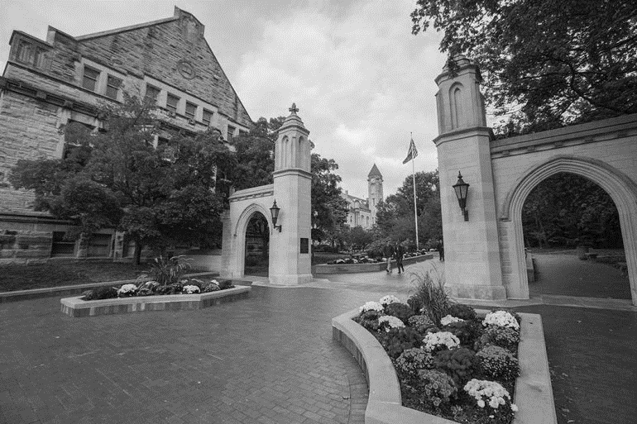
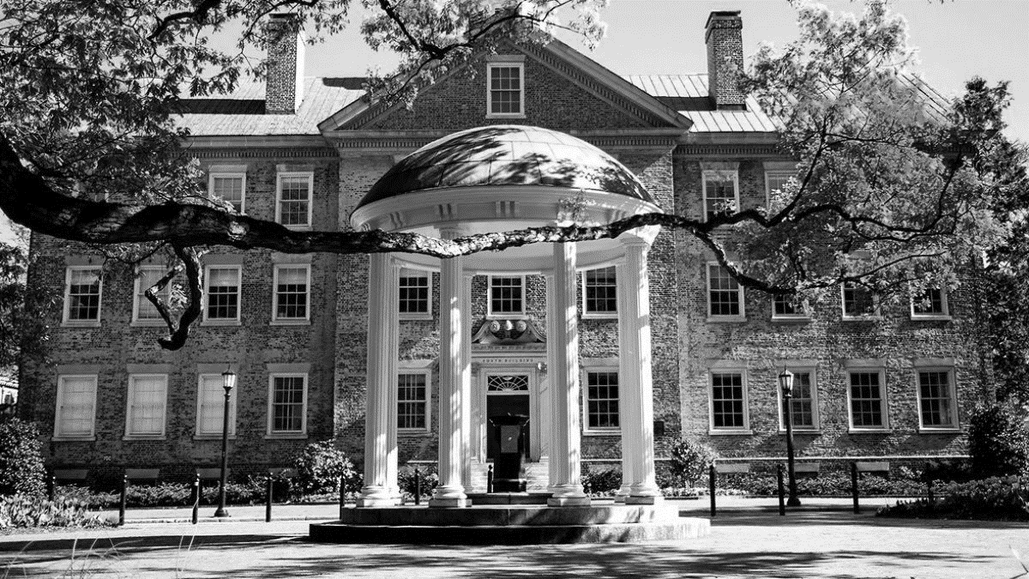
Executive Summary
Background
Graduates of America’s top-ranked public universities are extremely boastful about their college experiences, certain that they enjoyed a collegiate experience superior to that of all others. Long after graduation, they can be found wearing apparel featuring that the maize and blue of Michigan, the burnt orange of Texas, or Ohio State’s scarlet and gray.
Certainly, this pride comes from the academic rigor associated with the schools (highly quantified in rankings systems which have become a cottage industry unto themselves).
But more than just the quality of learning, arguments persist about who had the best college experience – which is the most quintessential college town. Some would say Madison. Some would say Berkeley. Some could argue Chapel Hill.
All this calls into question how important setting ends up being in the collegiate experience, and this becomes a question of heterogeneity. Do any of these college towns really stand out from the crowd in offering a unique experience via bars, restaurants, parks, and more? Do they cluster into a handful of types? Or are all of these well-known “college towns” more or less inseparable despite the insistence of those who lived out their college years there?
Objective
Using various data about the cities in which some of the top-ranked US public universities are located, we’ll set out to answer the question: to what extent are these college towns alike or different? Do they separate into any obvious clusters?
Audience
Primarily, this would speak to those students considering attending schools of this variety, helping them determine how much emphasis they should potentially place on basing their selections on other than academic ranking. And, in fact, some of the ways these cities and towns are quantified in the process could well become the basis for predictive models – helping students determine which locations and schools might best fit their preferences in terms of amenities.

Slide 3

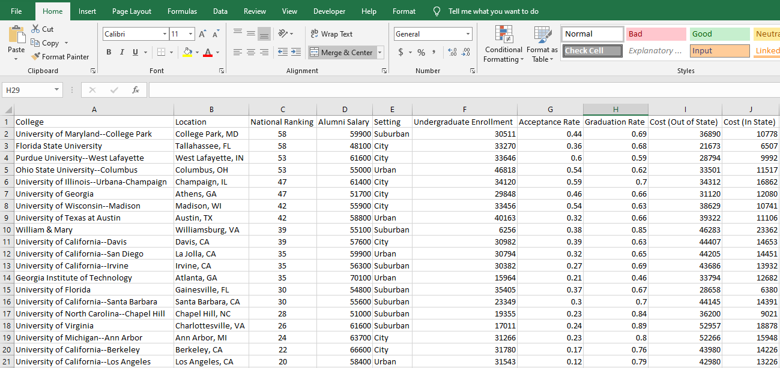
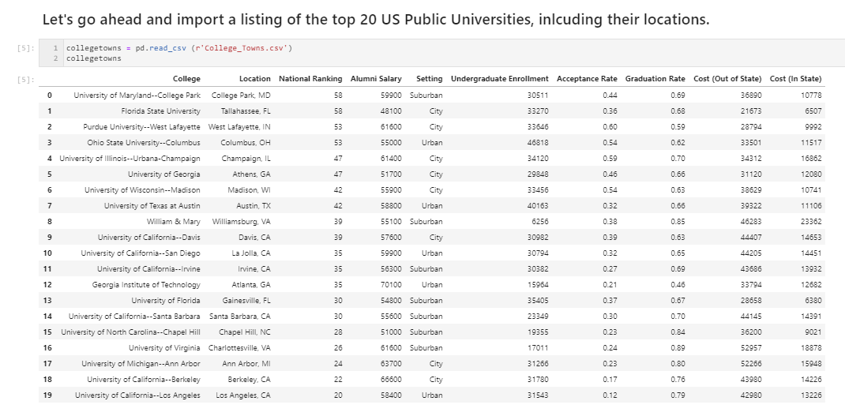
Data Collection & Preparation
Multi-Step Process
Find various high-quality sources of data that contribute to our findings
Scrape from HTML
Import .csv files
Make API calls
Bring these data into an environment (Juypter Notebook) in which we can employ data science tools (in this case, Python and associated libraries) to clean, structure, and manipulate them
Sources include:
U.S. News and World Report 2021 rankings of US Public Universities
Geolocation and city population data from https://simplemaps.com/data/us-zips
Foursquare Location Data via their developer API

Slide 4
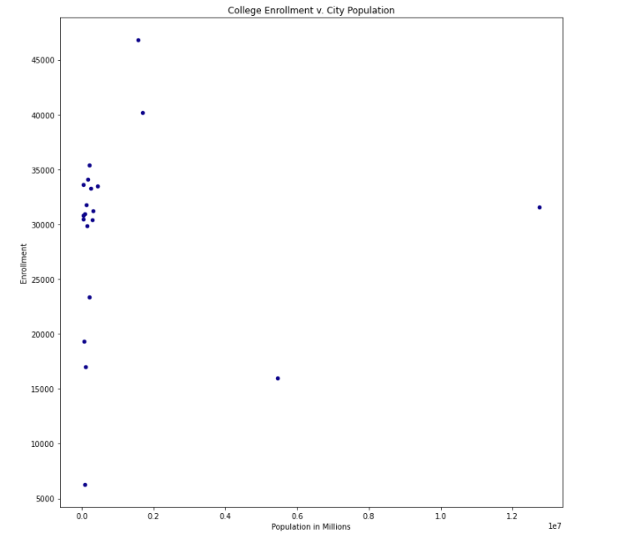
Initial Comparisons: Scatter Plot
Ohio State
Our goal is to do fair comparisons among schools and cities of a certain variety.
Even with just a quick inspection using basic visualization tools, we can see that we have some apparent clustering when we plot school enrollments and city populations, as well as quite a number of outliers.
Cities like Los Angeles (home to UCLA) and Atlanta (Georgia Tech), with overall populations in the millions, will present experiences far different than the others on a listing of cities with a median population of ~180K. These larger cities will offer a far different compliment of amenities (in both number and variety) than will the average college town.
Similarly, comparison between schools of a certain size become a little unfair. The College of William & Mary’s enrollment of 6,256 is roughly 40% the size of the next smallest school on the list, and Ohio State’s enrollment is ~17% larger than the next largest school on our initial list.
UCLA
Georgia Tech
William & Mary

Slide 5
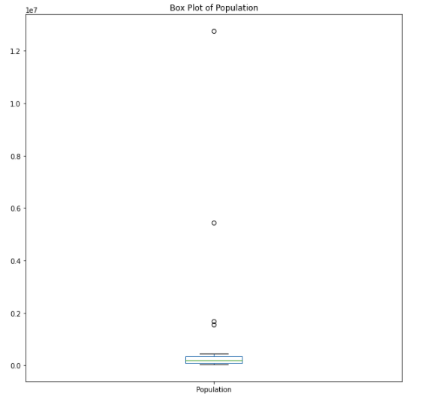
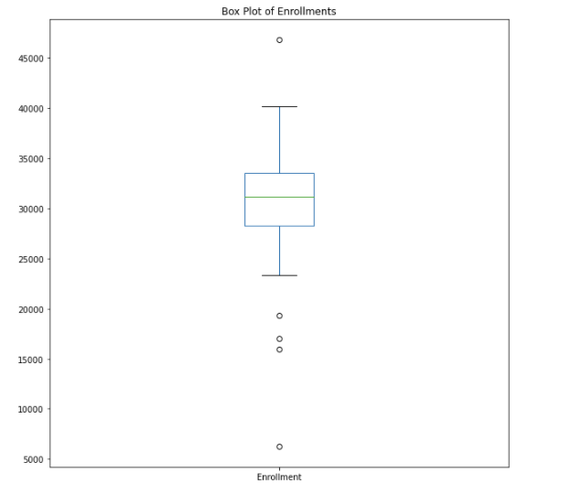
Initial Comparison: Box Plots
The extent to which there are outlying cities and schools is made more apparent still by plotting each the city populations and student enrollments using box plots.
To gauge homogeneity among college towns, we’ll want to normalize hone in on those schools and cities whose enrollments and populations don’t qualify as true outliers, falling outside the dataset norms. However, the very existence of this number of outliers (4) in a data set of only suggests heterogeneity in and of itself.

Slide 6
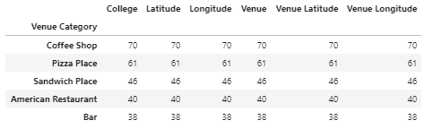
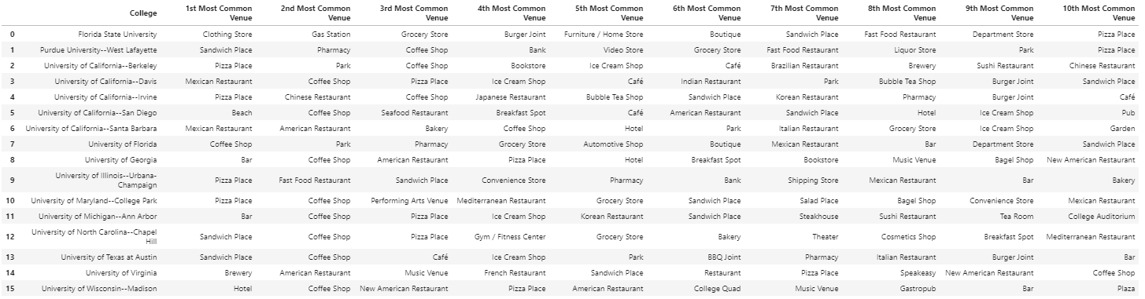
Venue Commonalities and Differences
Most Common Venue Types
We definitely see some of the themes we’d expect in terms of venue type in the overall counts across towns and schools (see table at left) – food and drink options with a social bent
However, if we make closer comparisons, we can see that the schools/cities are extremely distinct in terms of the frequency of occurrence of certain venue types:
Of the 60 distinct venue types appearing in the table, almost half (29) appear only once in the table; another 13 show up on twice.
6 of the 16 schools/cities have 3 unique venue types among their top 10; only 1 school (The University of Georgia) has no unique venue types in its 10 most-occurring
Most Common Venue Types by College Town

Slide 7
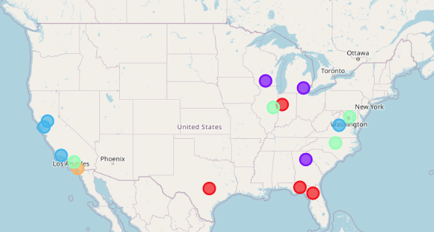
Clustering / Classification
Method
The schools were all classified give the prevalence of each type of venue in the overall Foursquare data set and matched based on similar preponderance into 5 clusters.
Findings:
Primarily, we see that geography doesn’t matter as much as one might have guessed it would:
We see two schools in Florida match up closely with one each in Texas and Indiana
The Northern CA schools do seem to cluster, but The University of Virginia also joined their cluster
We see one cluster that includes schools in CA, IL, MD and NC; we also see UCSD in its own cluster (probably because it was the lone to capture beaches, and as its most frequent venue type)
Our other cluster features two schools in the upper Midwest and one in GA

Slide 8
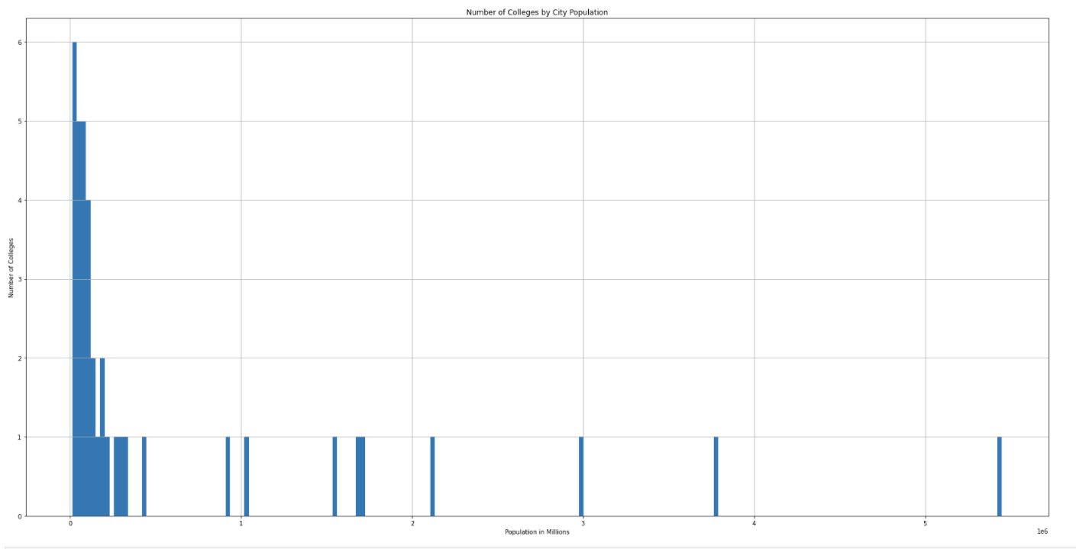
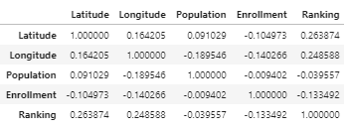
Deeper Dive: City Populations of College Towns
The schools we previously plotted largely hovered around a certain city population of about 200k
This begs the question: are those students interested in attending the highly ranked large public universities in the US more or less required to live in cities of a certain size?
To test, let’s bring in a larger sample size, totaling the top 40 schools and then plot the occurrence by city population using a histogram. Let’s leave out Los Angeles, however, as its massive size skews the results greatly
The resultant histogram seems to suggest that students do not need settle for living in cities of certain sizes – that there is a lot of diversity in the sub-500k population
Although this only seems to be the case as we brought in additional schools ranked 21-40. This begs the question of how correlated ranking might be to population. Let’s run a correlation on this larger data set to see
Bearing in-mind a small data set:
There are virtually no correlations of note in the table.
The highest is latitude by ranking, but even that's only at .264.
The comparison we looked at between ranking and city population is so miniscule .04, as to suggest that the factors are almost completely independent given our data set

Slide 9
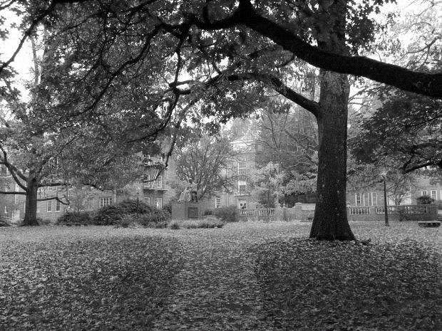
Conclusions
Even despite what seemed to be some apparent discernible patterns at first glance, we’ve basically proven that there’s great diversity in the schools
Highly-ranked public universities in the United States:
Come in a variety of sizes
Are in cities of widely divergent geographies and population sizes
Offer wide arrays of amenities even when geographies are alike
The near-complete lack of correlation we see across factors suggest as geospatial data, city population, and school ranking suggests that these schools, and the cities in which they reside, are fiercely unique
This lack of heterogeneity suggests that the choice of setting for one’s collegiate experience is significant and should factor into the decision-making process
In good news for would-be students of these schools, there’s a wealth of choice at their disposal – they can select a truly unique setting for their college careers

